Slide 1

Term project _8 Stroke Sight
안수빈 (ANH SUBIN) - 202334305
서현교 (SEO HYUNGYO) - 202334298
김원준 (KIM WONJUN) - 202239866
채희재 (CHAE HEEJAE) - 202135585

Slide 2
Contents
Mercury
Planet Mercury is the closest object to the Sun
1.Project Objective
4.Clustering
Stroke prediction and prevention through data science.
Grouping patients by health patterns using KMeans.
Mars
Despite being red, Mars is a cold place
2.Data Overview &
Inspection
5.Classification
5_1, 5_2 Evaluation+
Exploring dataset structure and stroke imbalance.
Predicting stroke with XGBoost and Decision Tree.
Jupiter
6. Strategic Insights & Team Wrap-up
Jupiter is a gas giant and the biggest planet
3.Preprocessing
Cleaning and transforming data for modeling.
Proposing prevention strategies and reviewing teamwork.

Slide 3
1. project objective

Slide 4
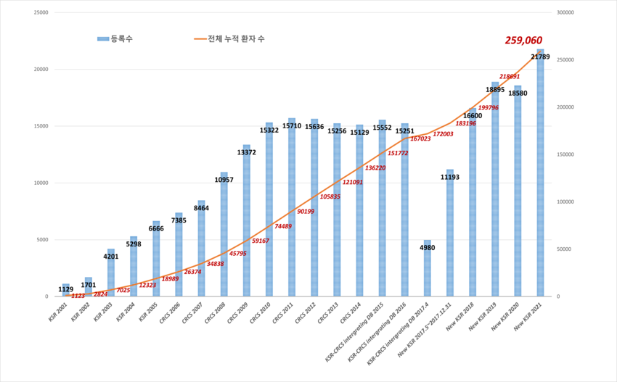
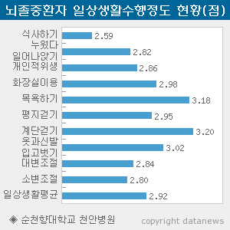
1.Project objective _ motivation
“Growth in Stroke Patient Population (2001–2021)”
“Daily Functional Limitations of Stroke Patients”

Slide 5
1.Project objective _ objective
01
1. Stroke risk predictionUsing health
02
2. Group patients by similarity
03
3. Personalized prevention
04
4. StrokeSight’s Goal Summary

Slide 6
2. Data overview & inspection

Slide 7

2. Data Overview _1
Stroke Prediction Dataset (Kaggle)
https://www.kaggle.com/datasets/fedesoriano/stroke-prediction-dataset
This dataset includes health records of over 5,000 individuals. It aims to predict whether a person is likely to have a stroke.

Slide 8
2. Data Overview _2

Slide 9
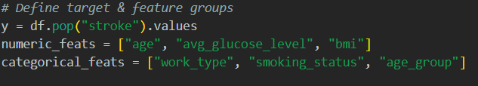
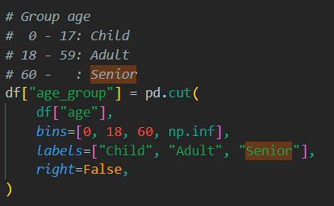
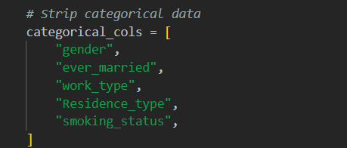
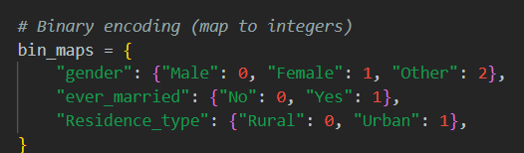
2. Data inspection

Slide 10
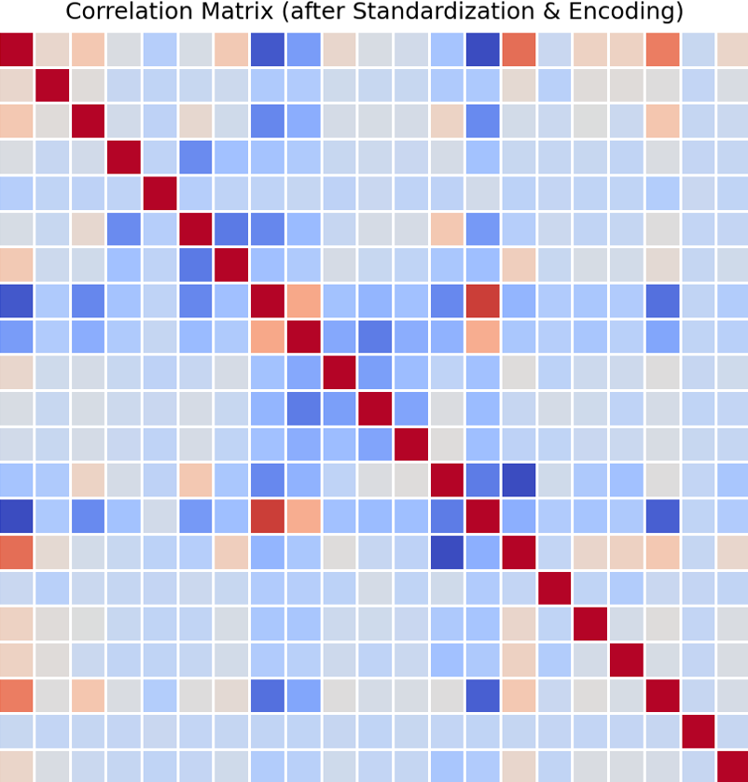
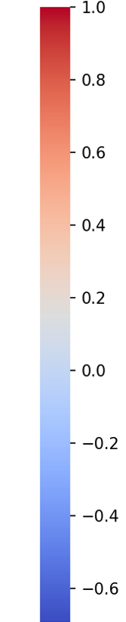
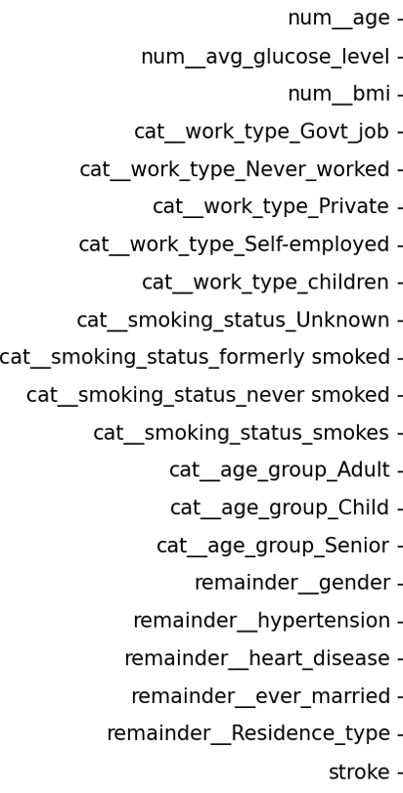
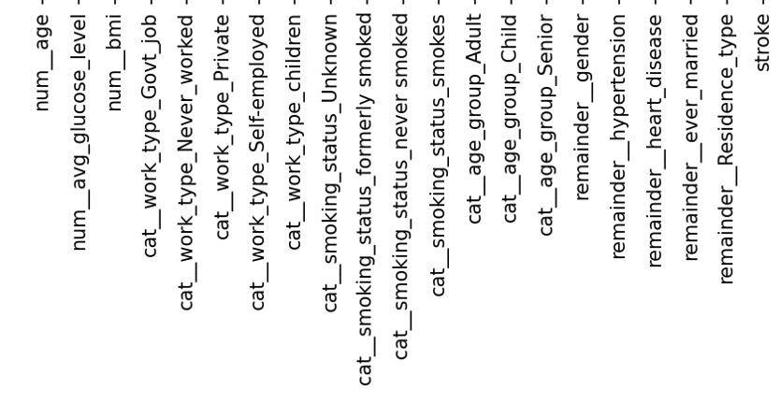
2. Data inspection_Correlation Matrix

Slide 11
3. Preprocessing

Slide 12
3. Preprocessing_dataOverView
Category | Description
Raw Data Size | 5,110 rows × 12 columns
Features After Preprocessing | 20 features (3 numeric + 12 one-hot + 5 binary)
Numeric Features (3) | age, avg_glucose_level, bmi
One-hot Features (12) | work_type (5), smoking_status (4), age_group (3)
Binary Features (5) | gender, hypertension, heart_disease, ever_married, Residence_type
Train/Test Split | 80% / 20% stratified split
X_train Shape | (4,088 × 20)
X_test Shape | (1,022 × 20)

Slide 13
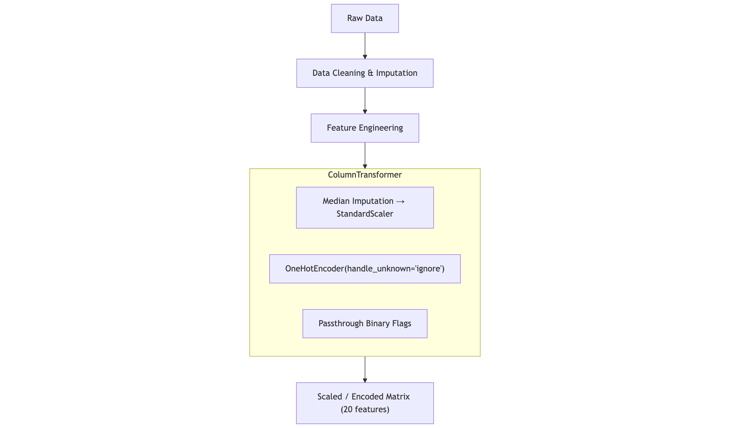
3. Preprocessing pipeline + cleaning & imputation
Step | Detailed Actions | Rationale
Remove ID column | Drop id | Prevents data leakage
String normalization | Trim whitespace, unify capitalization, map to Unknown | Reduces sparsity in one-hot encoding
BMI missing values | Median imputation | Median reduces the impact of outliers

Slide 14
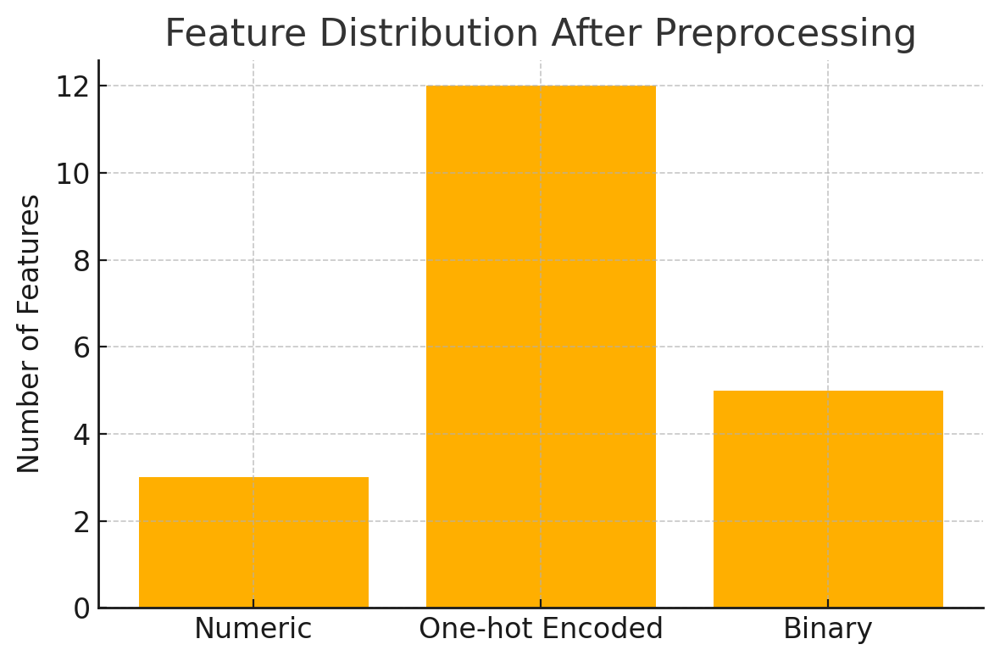
3. Feature Engineering + Column Partition & Transformers
Type | Example Columns (post-processed) | Transformation
Numeric (3) | num__age, num__avg_glucose_level, num__bmi | StandardScaler
One-hot (12) | cat__work_type_* (5), cat__smoking_status_* (4), cat__age_group_* (3) | OneHotEncoder (12 cols)
Binary (5) | remainder__gender, remainder__hypertension, remainder__heart_disease, remainder__ever_married, remainder__Residence_type | Passthrough
Total features after preprocessing: 3 + 12 + 5 = 20

Slide 15
3. Final Feature List
Feature Name | Description | Notes
age | Age | Scaled (StandardScaler)
avg_glucose_level | Average glucose level | Scaled
bmi | Body Mass Index | Scaled, missing → median
work_type_* | Work type categories | One-hot (5: Govt, Private…)
smoking_status_* | Smoking status categories | One-hot (4 types)
age_group_* | Age group buckets | One-hot (Child/Adult/Senior)
gender | Gender (Male=0, Female=1, Other=2) | Binary encoded
hypertension | Has hypertension (0/1) | Binary
heart_disease | Has heart disease (0/1) | Binary
ever_married | Ever married (0/1) | Binary
Residence_type | Living area (0=Rural, 1=Urban) | Binary
Stroke is the target variable of our project, where 1 indicates a stroke occurred and 0 means it did not.

Slide 16
3. Preprocessing Validation & Summary
One –Hot Encoding Validation
Train/Test distribution Cehck
01
02
Each one-hot group sums to 1
(no encoding error).
Numeric feature stats differ less than 0.5σ.
03
Featrue Order Consistency
04
Final Input Configuration
Ensures reproducibility during model training and evaluation.
20 clean features ready for model.

Slide 17
4. Clustering

Slide 18
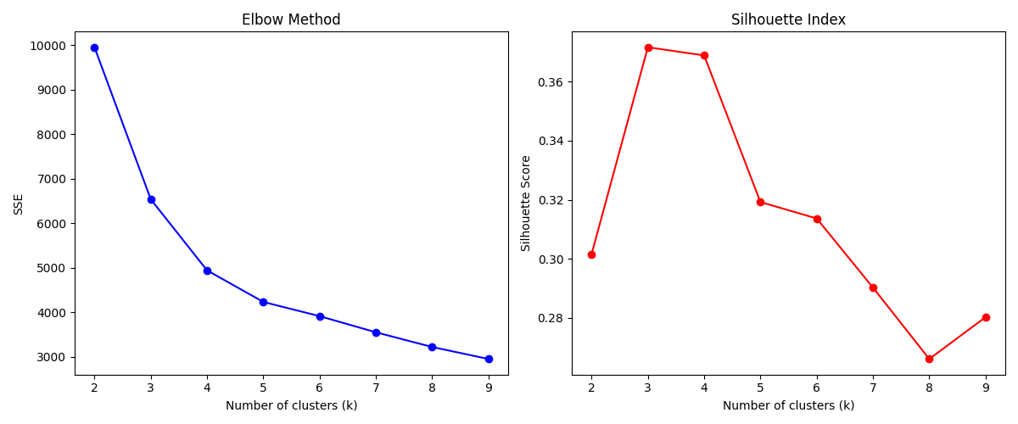
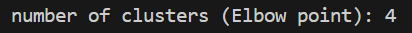
4. Clustering Analysis – KMeans Overview

Slide 19
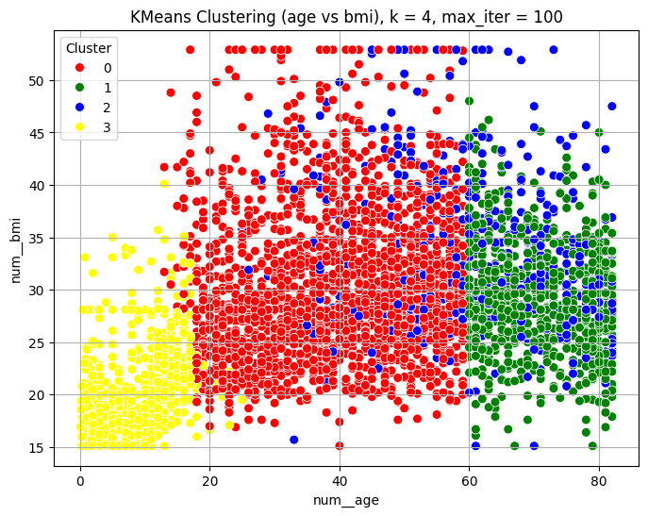

4. Clustering – PCA & Feature-Based Visualization

Slide 20
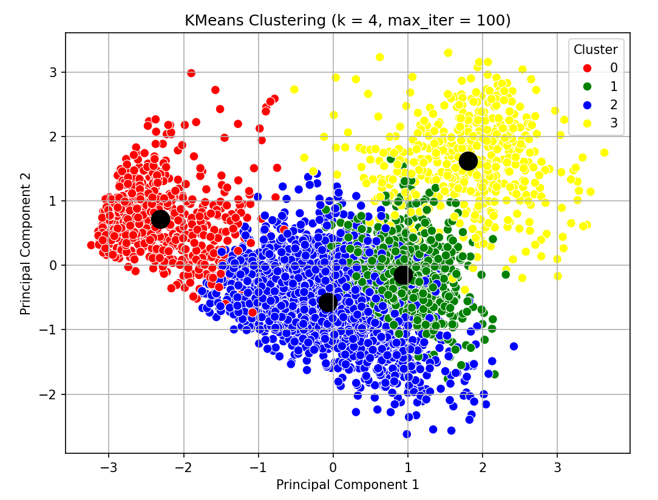
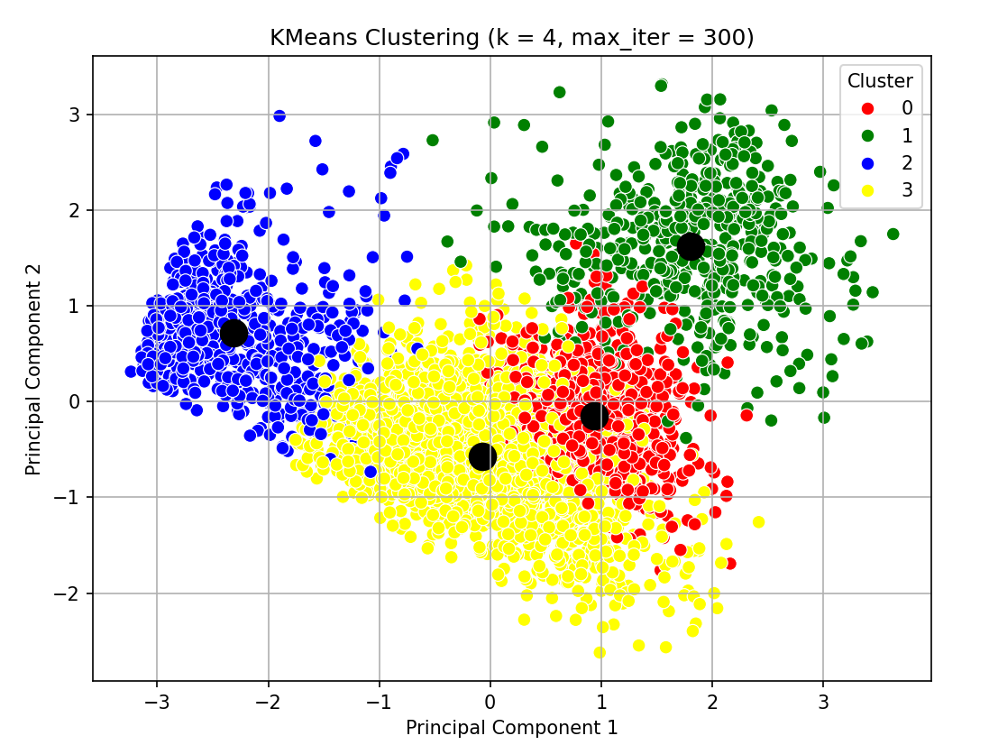
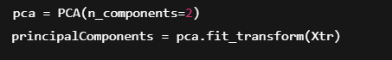
4. Clustering– Feature Summary & Risk Analysis

Slide 21
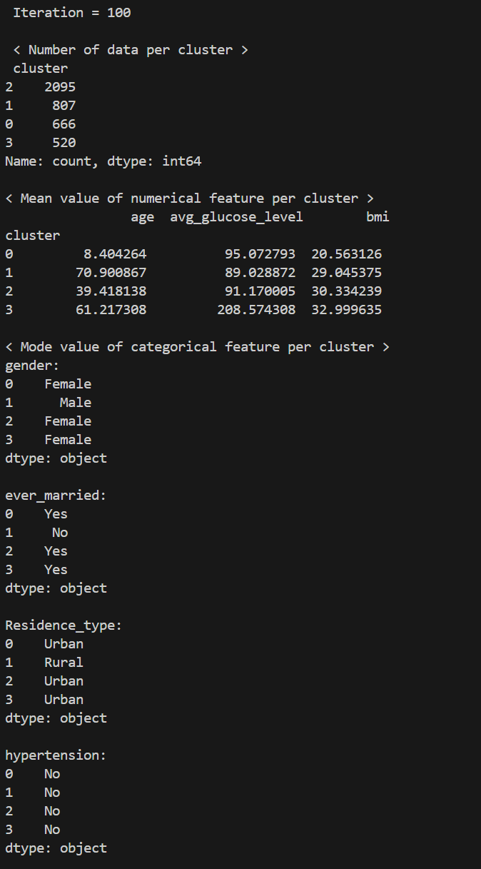
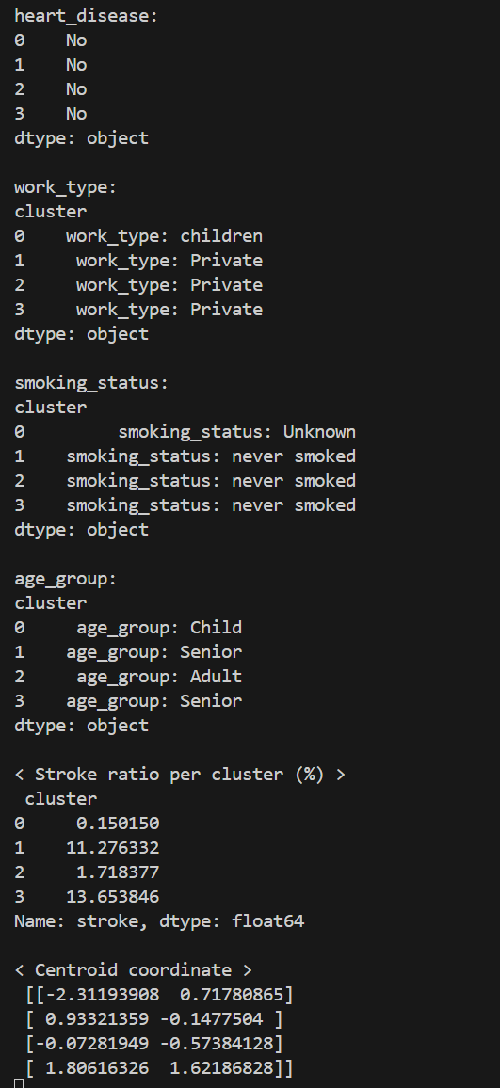
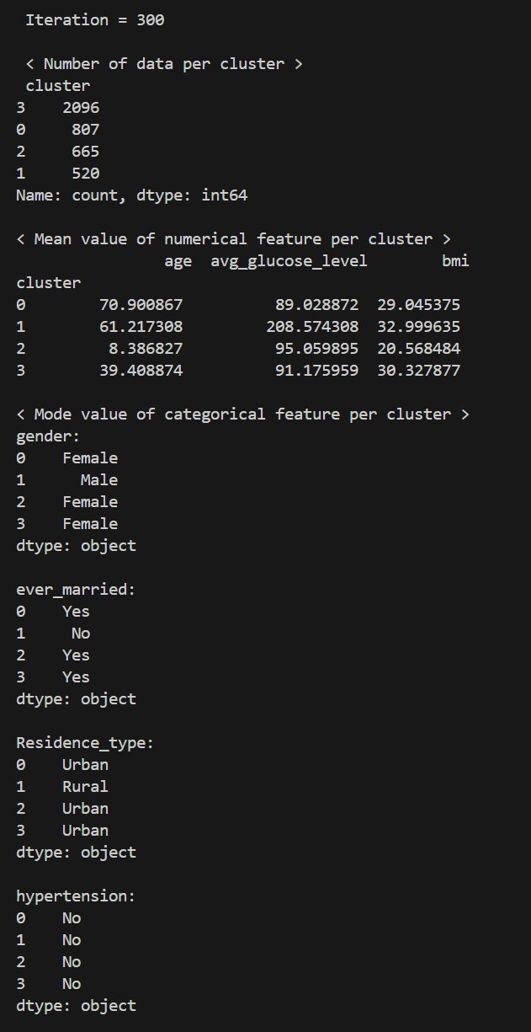
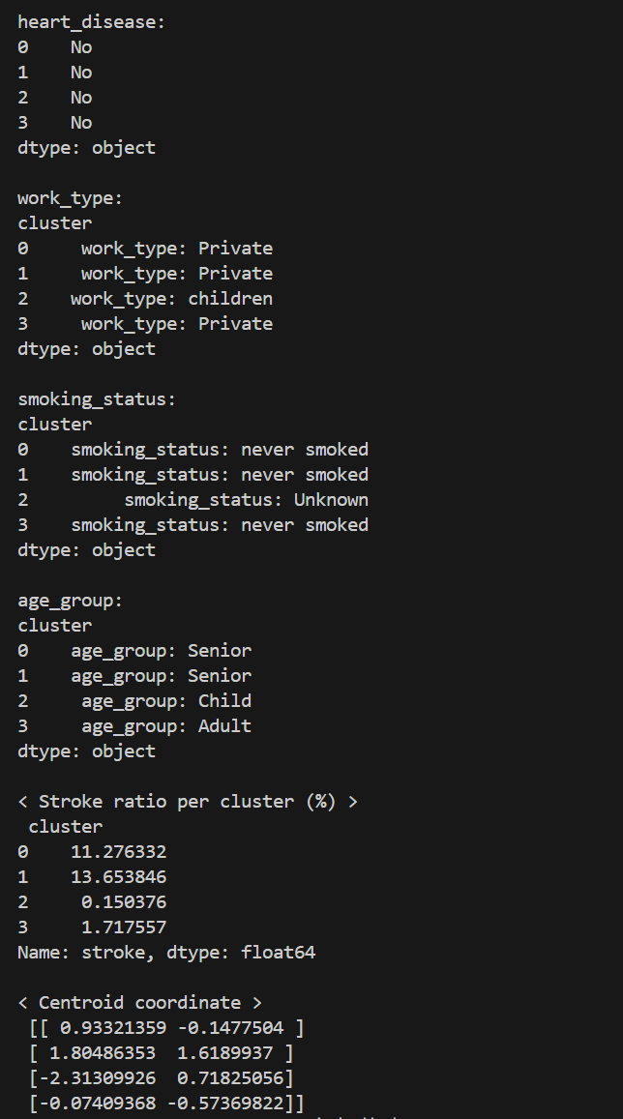
4.Clustering – Impact of Iterations on Feature Stability

Slide 22
4.Clustering – Stroke Risk by Cluster
 | Cluster 0 | Cluster 1 | Cluster 2 | Cluster 3
Age (mean) | 71 | 61 | 8 | 39
Age Group (mode) | Senior | Senior | Child | Adult
Glucose (mean) | 89 | 209 | 95 | 91
BMI (mean) | 29 | 33 | 21 | 30
Gender (Mode) | F | M | F | F
Ever Married (mode) | O | X | O | O
Residence Type (mode) | Urban | Rural | Urban | Urban
Hypertension (mode) | X | X | X | X
Heart Disease (mode) | X | X | X | X
Work Type (mode) | Private | Private | children | Private
Smoking Status (mode) | X | X | ? | X
Stroke Ratio | 11.3 | 13.7 | 0.2 | 1.7

Slide 23
5. classification

Slide 24
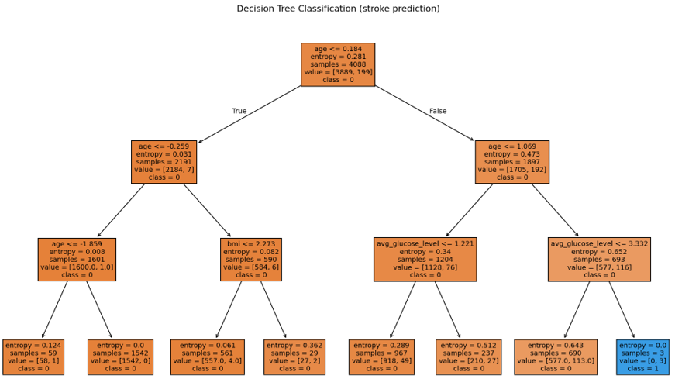
5. Classification – Overview of Decision Tree

Slide 25
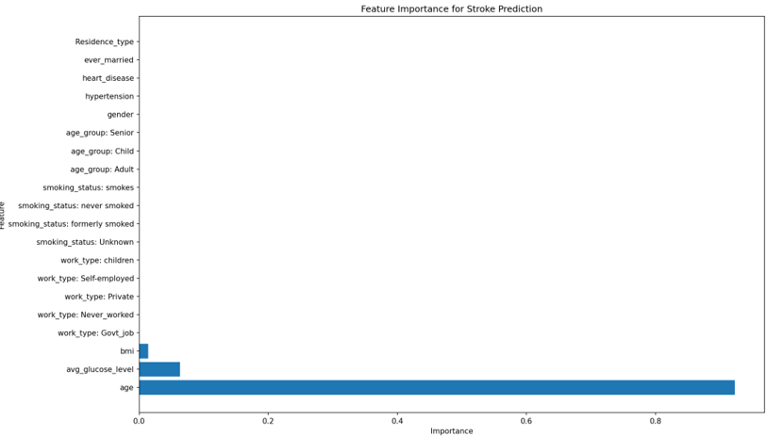
5. Classification – Model Training & Parameters

Slide 26
5_1. Model Overview &
Handling Imbalance

Slide 27
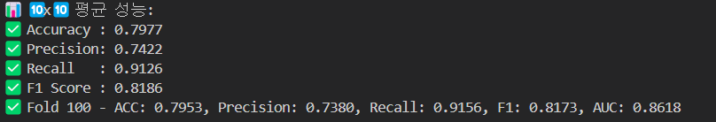
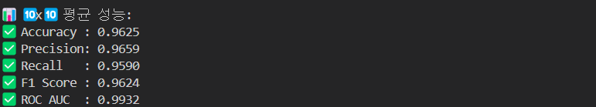
5_1. Model Comparison – XGBoost vs Decision Tree
1.Decision Tree
2.Xg Boost

Slide 28
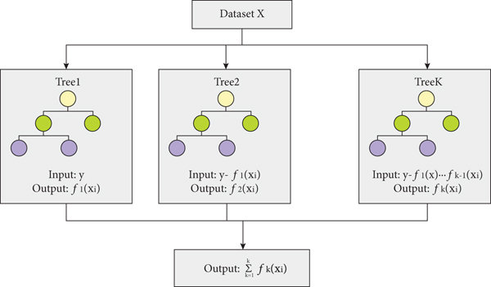
5_1. XGBoost – Mechanism & Advantages

Slide 29
5_2. Model Evaluation & Comparison

Slide 30
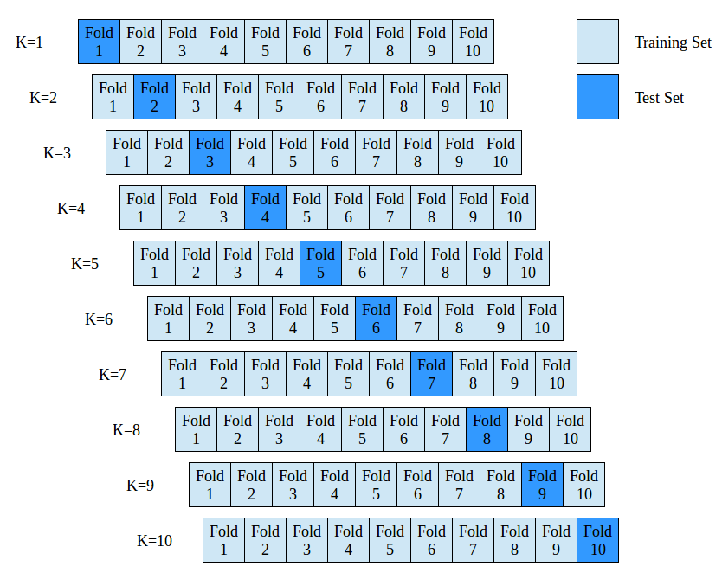
5_2. Cross-validation – 10x10 KFold

Slide 31
5_2. Modeling Summary
Metric | Description
Accuracy | Proportion of correct predictions overall
Precision | Proportion of true positives among predicted positives
Recall | Proportion of actual positives correctly identified
F1 Score | Harmonic mean of Precision and Recall
ROC AUC | Evaluation metric reflecting performance across classification thresholds

Slide 32
5_2 Evaluation - result Analysis
Model | Accuracy | Precision | Recall | F1 Score | ROC AUC
XGBoost | 0.9625 | 0.9659 | 0.9590 | 0.9624 | 0.9932
Decision Tree | 0.7977 | 0.7422 | 0.9126 | 0.8186 | 0.8554

Slide 33
6. Strategic insights& Team Wrap –up

Slide 34

6. Cluster-specific Prevention Recommendations"
 | Cluster 0 | Cluster 1 | Cluster 2 | Cluster 3
Age (mean) | 71 | 61 | 8 | 39
Age Group (mode) | Senior | Senior | Child | Adult
Glucose (mean) | 89 | 209 | 95 | 91
BMI (mean) | 29 | 33 | 21 | 30
Gender (Mode) | F | M | F | F
Ever Married (mode) | O | X | O | O
Residence Type (mode) | Urban | Rural | Urban | Urban
Hypertension (mode) | X | X | X | X
Heart Disease (mode) | X | X | X | X
Work Type (mode) | Private | Private | children | Private
Smoking Status (mode) | X | X | ? | X
Stroke Ratio | 11.3 | 13.7 | 0.2 | 1.7

Slide 35
6. Team Roles and Reflections
Team Member | One-line Review
Subin | Deepened understanding by directly experiencing supervised and unsupervised learning
Seohyun | Realized the importance of preprocessing and gained hands-on experience with real data
Wonjun | Recognized the importance of model selection and evaluation through various experiments
Heejae | Completed the data analysis journey by experiencing the entire project process
Team Member | Role
Seohyun K. | Data Preprocessing
Subin A. | Clustering Analysis
Wonjun K. | Classification Modeling & Evaluation
Heejae C. | Overall Workflow & Presentation

Slide 36
6.Limitations, Q&A & Team Summary
1. Why XGBoost Outperforms Decision Tree
2. Reason for Choosing 4 Clusters
3. Addressing Class Imbalance
4. Project Workflow
One
Two
Three
Four

Slide 37
GitHub Link
https://github.com/datascienceteam8/datascienceteam8
Reference
1.https://www.datanews.co.kr/news/article.html?no=3189
2. https://kormedi.com/1597967
3. https://www.researchgate.net/figure/K-fold-cross-validation-method-diagram-K-10_fig2_343811122
4. https://www.researchgate.net/figure/Flow-chart-of-XGBoost-framework_fig4_357640947
5. Stroke Prediction Dataset – Kaggle
6. https://www.elastic.co/kr/industries/healthcare

